Slide 1
ET NavSwarm
Nick Snyder (CE)
Advisors: Yu, Mahmud, Thein (ME)

Slide 2
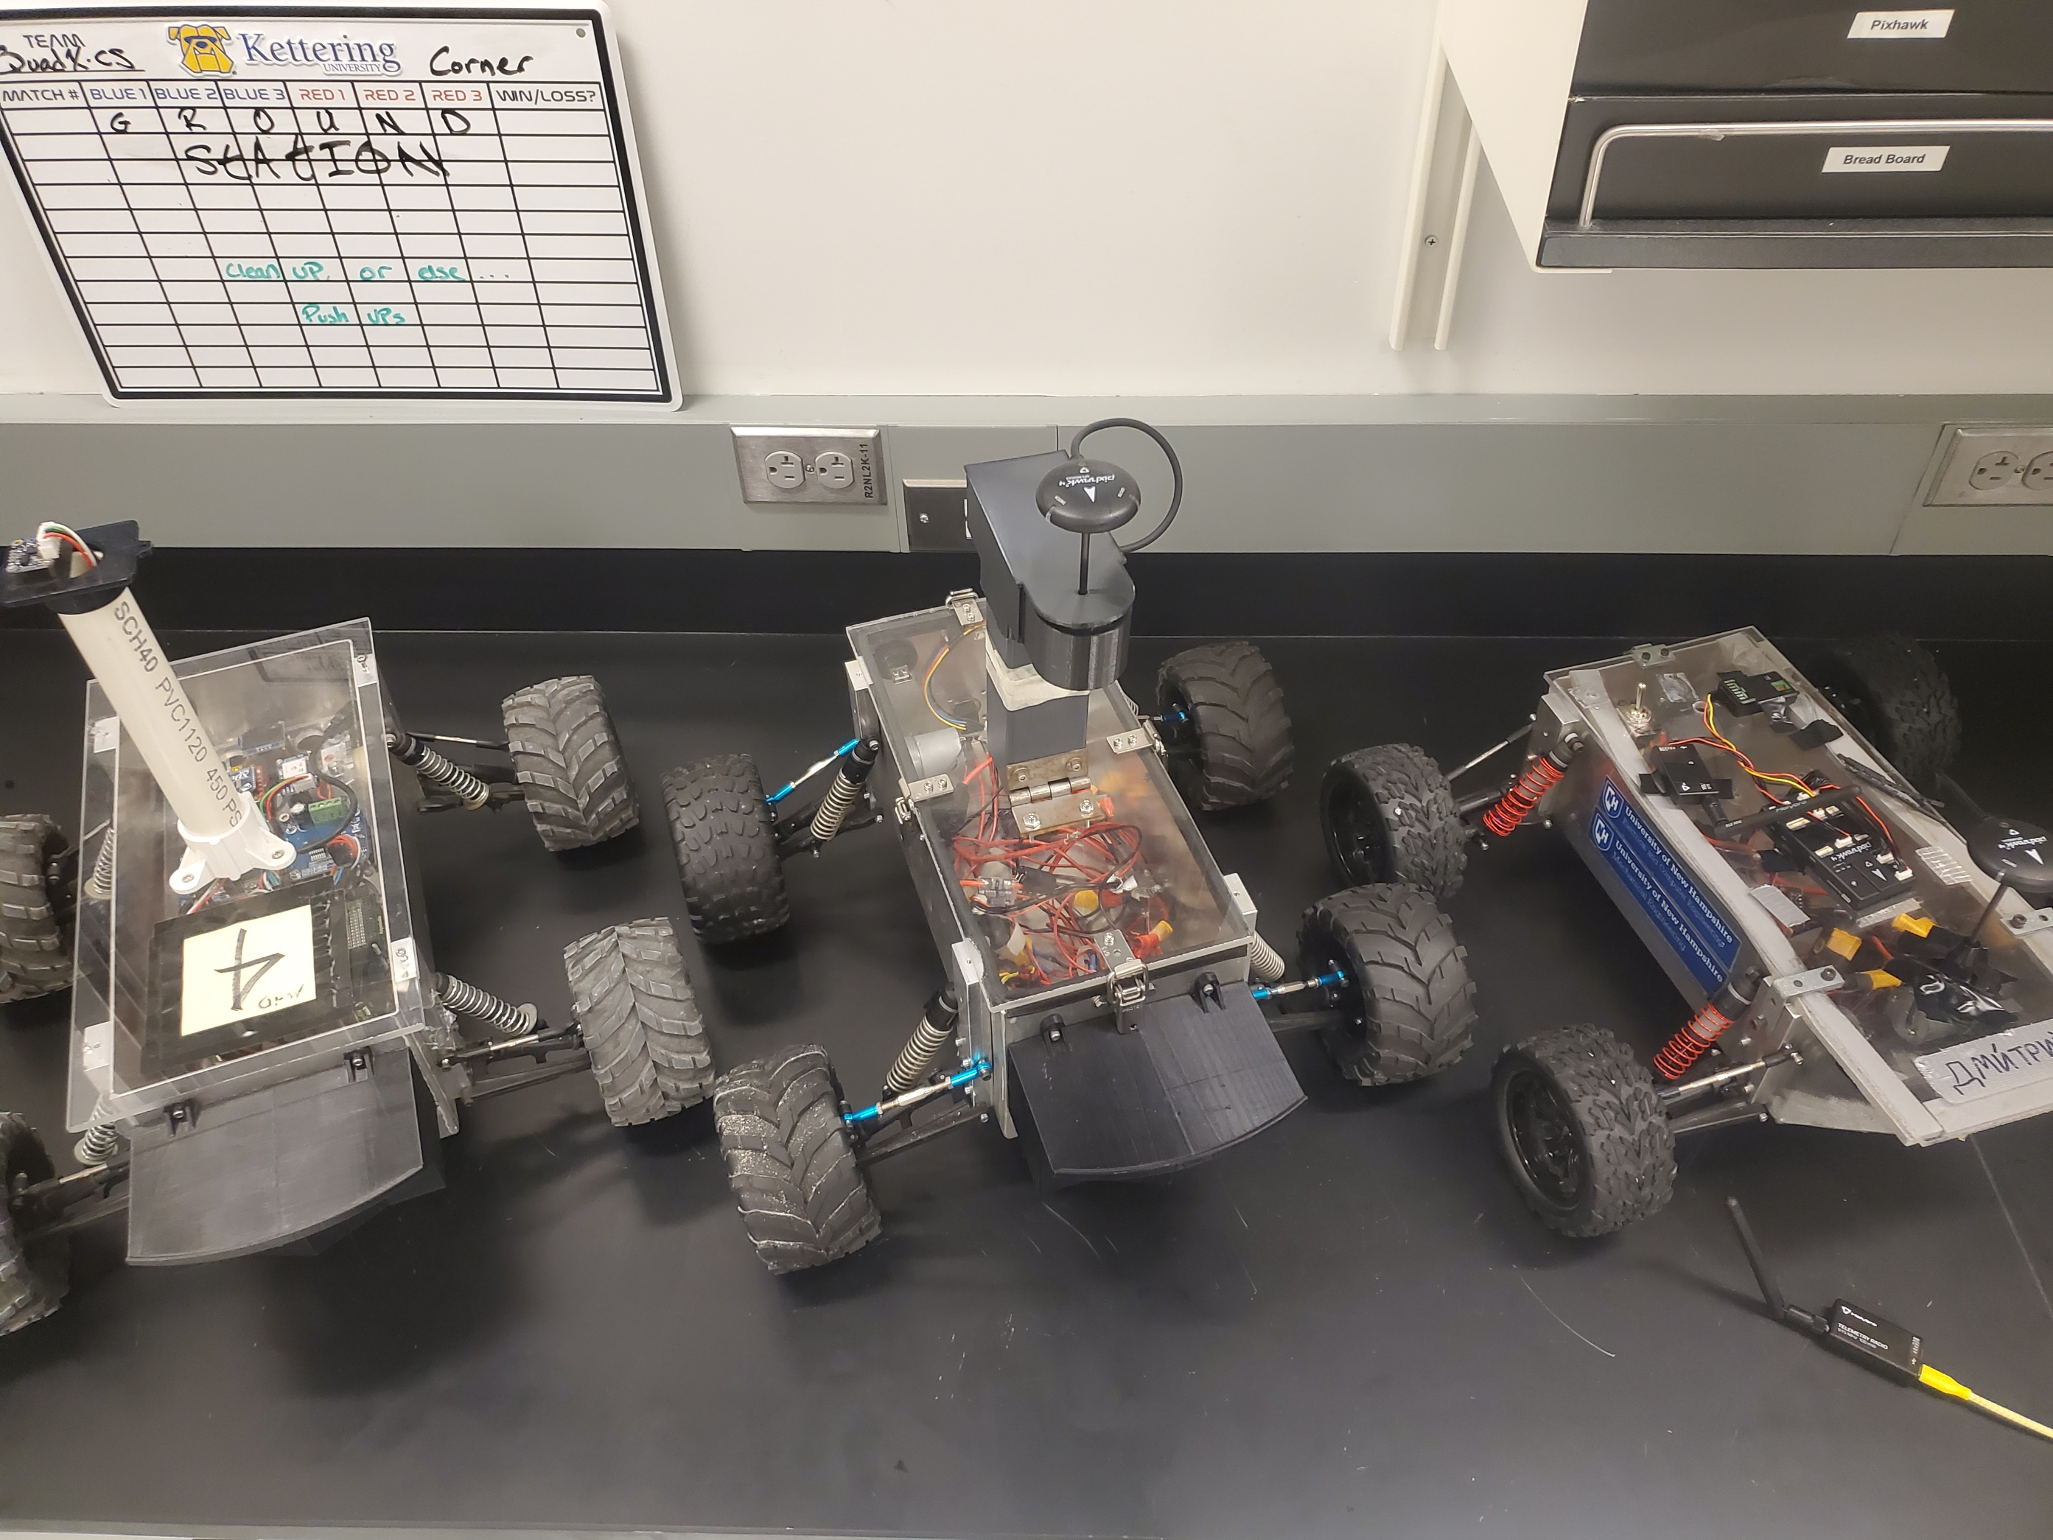
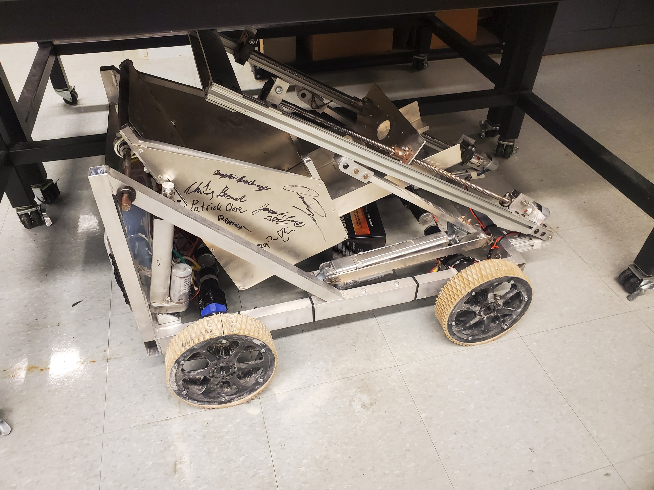
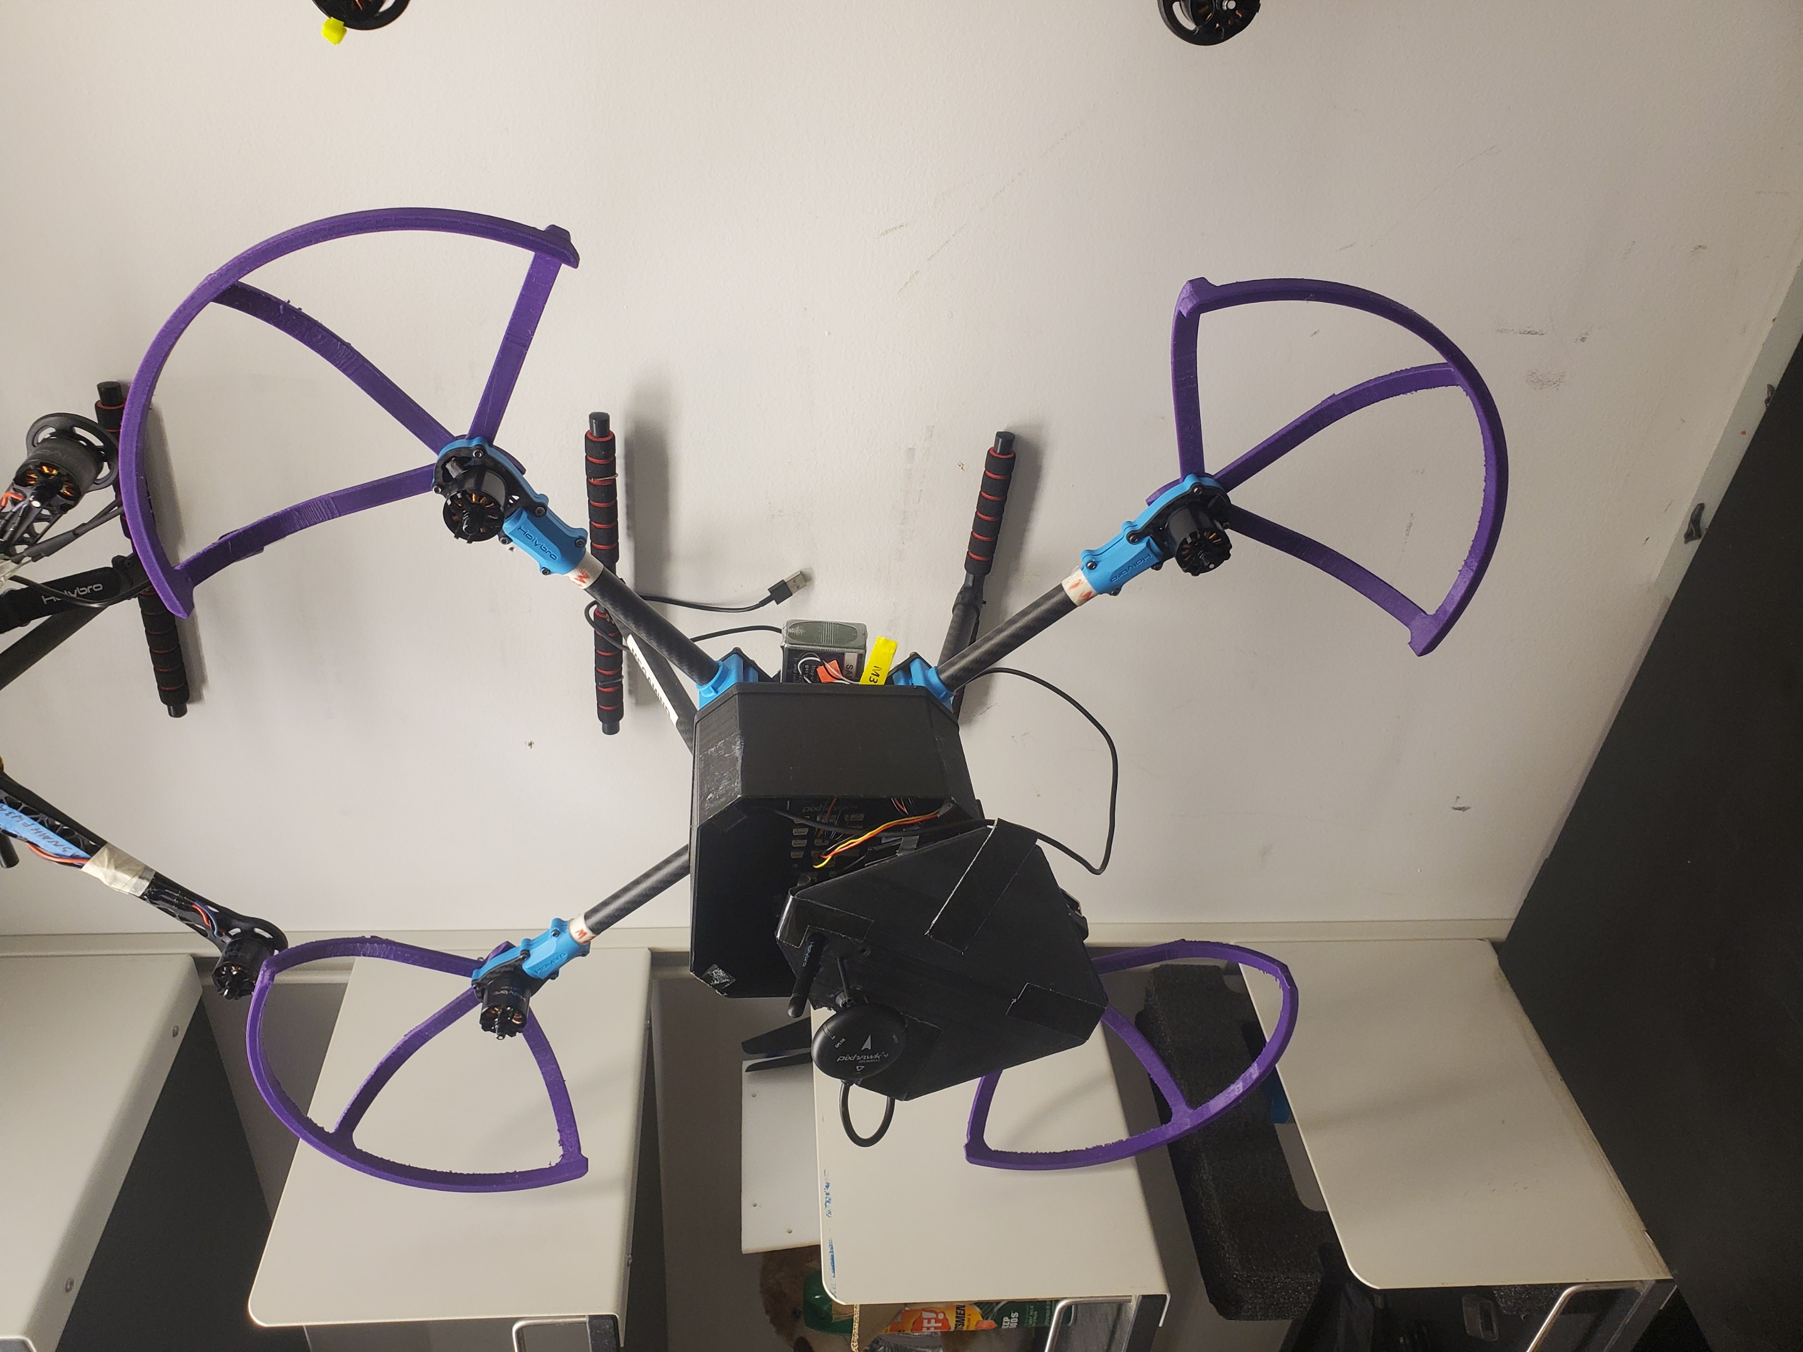
What is ET NavSwarm?
Fleet of autonomous rovers
Goal of prospecting for extraterrestrial materials
Integration with other ACL projects

Slide 3

Current State
Arduino-based rovers
Pixhawk-based rovers
Sensor array
Team
Autonomous control
Documentation

Slide 4
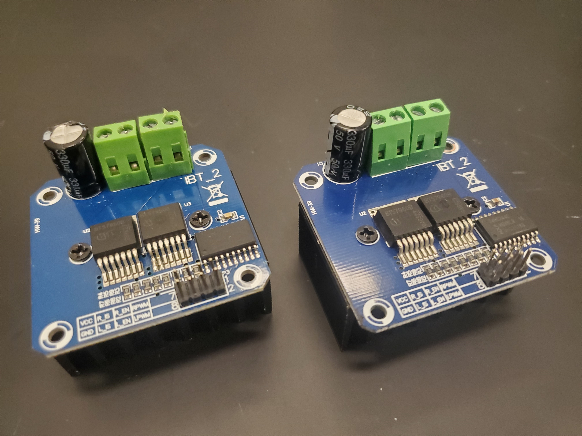
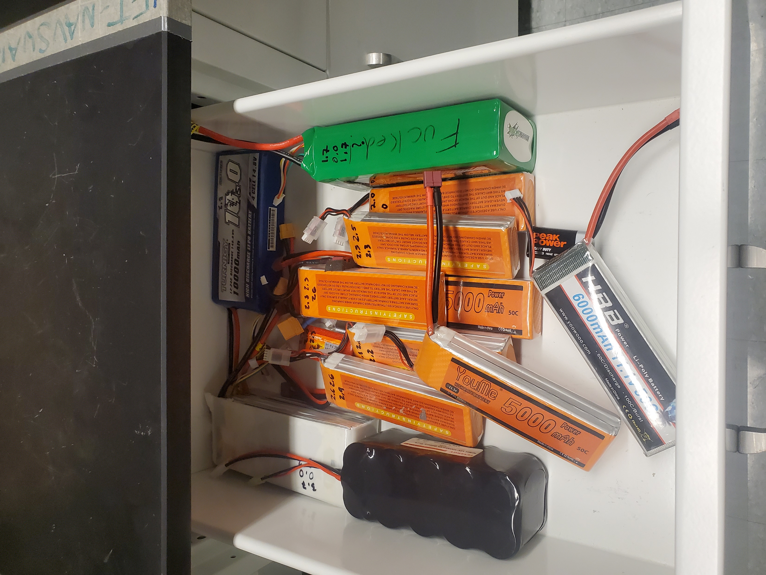
My Contribution
Wiring Diagram
Mess of wires
ESC
Battery monitoring

Slide 5



What I will use
Multisim – circuit design
KiCad – PCB layout
JLCPCB - fabrication
Lab Equipment – testing and verification

Slide 6
Proposed Budget
Raw materials
PCB fabrication
Not including whole rover cost or launch cost

Slide 7
Design Considerations
Brushed speed control (PWM)
Ease of troubleshooting (Low battery indicators)
Robust design (Sturdy mounting)

Slide 8
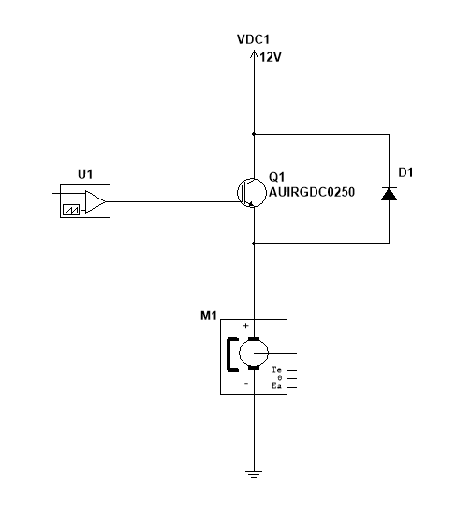
Speed Controller
IGBT

Slide 9
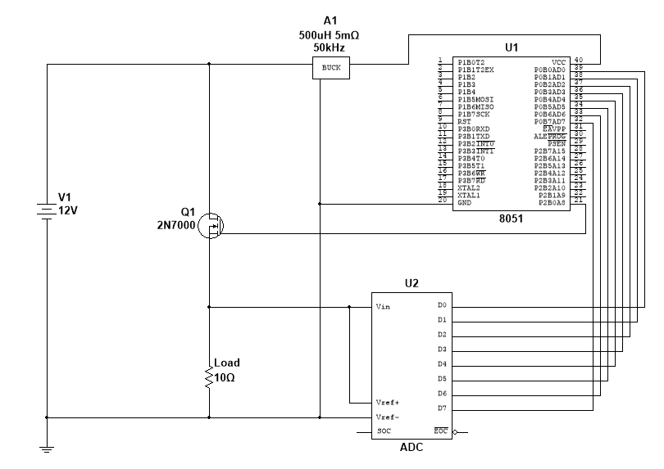
Battery Monitor
FET
Buck Converter
8-bit ADC
MCU

Slide 10
Projected Timelines
Event planning
Design
Fabrication
Testing/Programming
Revisions
Conference prep

Slide 11
Q/A

